Slide 1
SUPERVISED LEARNING: CLASSIFICATION
Divide and Conquer: Decision Trees and Rules

Slide 2
Introduction
While deciding between several job offers with various levels of pay and benefits, many people begin by making lists of pros and cons, and eliminate options based on simple rules. For instance, ''if I have to commute for more than an hour, I will be unhappy.'' Or, ''if I make less than $50k, I won't be able to support my family.'' In this way, the complex and difficult decision of predicting one's future happiness can be reduced to a series of simple decisions.

Slide 3
Decision tree
Decision tree learners are powerful classifiers, which utilize a tree structure to model the relationships among the features and the potential outcomes. As illustrated in the following figure, this structure earned its name due to the fact that it mirrors how a literal tree begins at a wide trunk, which if followed upward, splits into narrower and narrower branches. In much the same way, a decision tree classifier uses a structure of branching decisions, which channel examples into a final predicted class value.

Slide 4
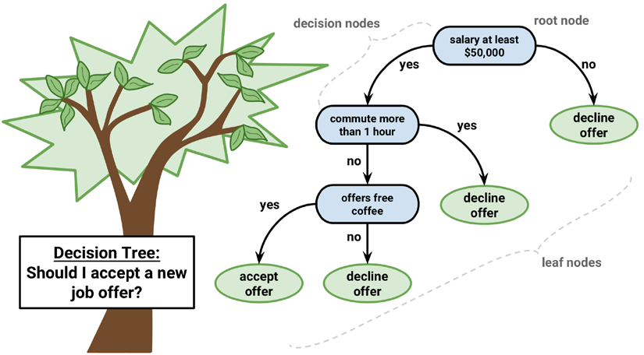

Slide 5
Some potential uses include:
• Credit scoring models in which the criteria that causes an applicant to be rejected need to be clearly documented and free from bias
• Marketing studies of customer behavior such as satisfaction or churn, which will be shared with management or advertising agencies
• Diagnosis of medical conditions based on laboratory measurements, symptoms, or the rate of disease progression

Slide 6
In spite of their wide applicability, it is worth noting some scenarios where trees may not be an ideal fit. One such case might be a task where the data has a large number of nominal features with many levels or it has a large number of numeric features. These cases may result in a very large number of decisions and an overly complex tree. They may also contribute to the tendency of decision trees to overfit data

Slide 7
Divide and Conquer
Decision trees are built using a heuristic called recursive partitioning. This approach is also commonly known as divide and conquer because it splits the data into subsets, which are then split repeatedly into even smaller subsets, and so on and so forth until the process stops when the algorithm determines the data within the subsets are sufficiently homogenous, or another stopping criterion has been met.

Slide 8
Divide and conquer might stop at a node in a case that:
• All (or nearly all) of the examples at the node have the same class
• There are no remaining features to distinguish among the examples
• The tree has grown to a predefined size limit

Slide 9
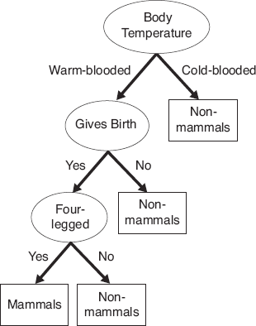
Example

Slide 10
To illustrate the tree building process, let's consider a simple example. Imagine that you work for a Hollywood studio, where your role is to decide whether the studio should move forward with producing the screenplays pitched by promising new authors. After returning from a vacation, your desk is piled high with proposals. Without the time to read each proposal cover-to-cover, you decide to develop a decision tree algorithm to predict whether a potential movie would fall into one of three categories: Critical Success, Mainstream Hit, or Box Office Bust.

Slide 11
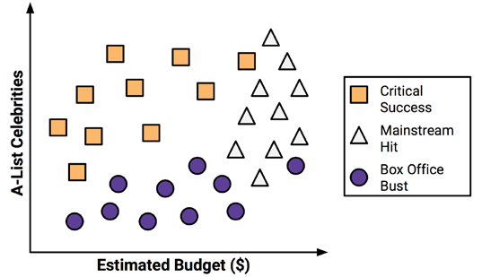

Slide 12
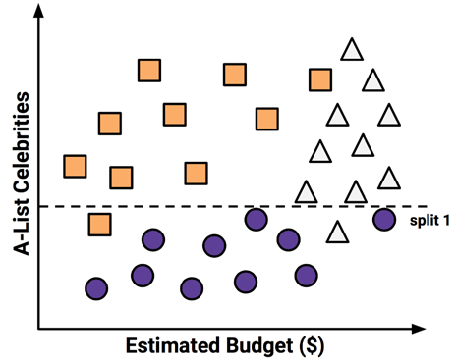
Split the feature indicating the number of celebrities, partitioning the movies into groups with and without a significant number of A-list stars:

Slide 13
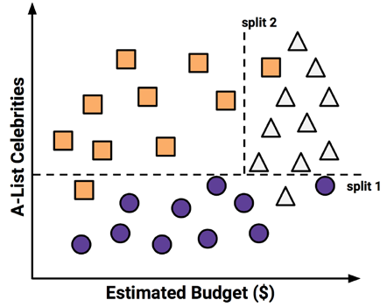
among the group of movies with a larger number of celebrities, we can make another split between movies with and without a high budget:

Slide 14
At this point, we have partitioned the data into three groups. The group at the top-left corner of the diagram is composed entirely of critically acclaimed films. This group is distinguished by a high number of celebrities and a relatively low budget. At the top-right corner, majority of movies are box office hits with high budgets and a large number of celebrities. The final group, which has little star power but budgets ranging from small to large, contains the flops.

Slide 15
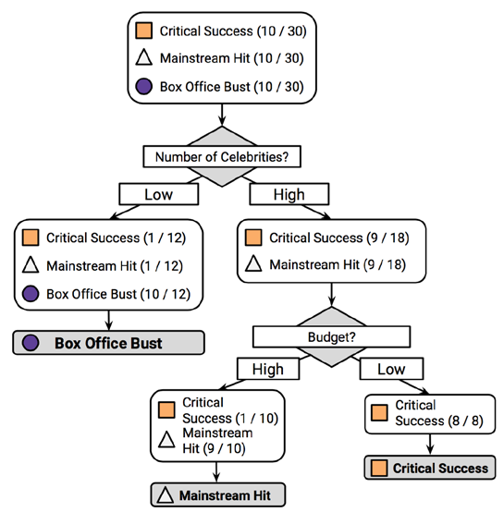

Slide 16
The C5.0 decision tree algorithm
The C5.0 algorithm has become the industry standard to produce decision trees, because it does well for most types of problems directly out of the box. Compared to other advanced machine learning models, the decision trees built by C5.0 generally perform nearly as well, but are much easier to understand and deploy.

Slide 17
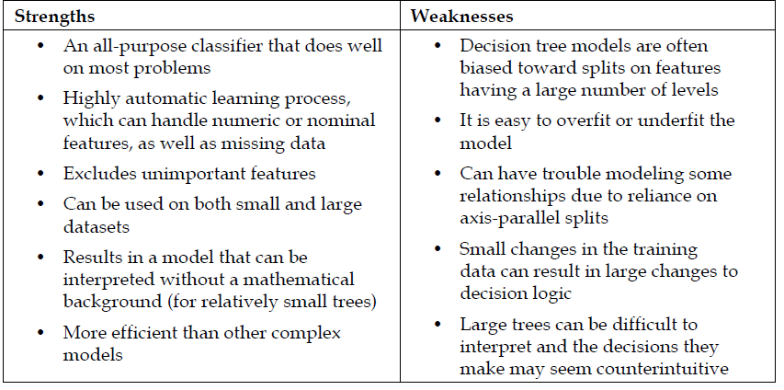

Slide 18
Tree based learning algorithms are considered to be one of the best and mostly used supervised learning methods (having a pre-defined target variable).
Decision tree are powerful non-linear classifiers, which utilize a tree structure to model the relationships among the features and the potential outcomes. A decision tree classifier uses a structure of branching decisions, which channel examples into a final predicted class value.

Slide 19
The decision tree model follows the steps outlined below in classifying data:
It puts all training examples to a root.
It divides training examples based on selected attributes.
It selects attributes by using some statistical measures.
Recursive partitioning continues until no training example remains, or until no attribute remains, or the remaining training examples belong to the same class.

Slide 20
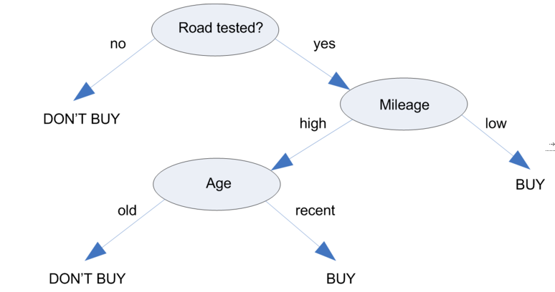
Decision Tree on Car Purchase

Slide 21
Choosing the best split
The first challenge that a decision tree will face is to identify which feature to split upon.
The degree to which a subset of examples contains only a single class is known as purity, and any subset composed of only a single class is called pure.
There are various measurements of purity that can be used to identify the best decision tree splitting candidate.
C5.0 uses entropy, that quantifies the randomness, or disorder, within a set of class values.

Slide 22
The decision tree hopes to find splits that reduce entropy, ultimately increasing homogeneity within the groups.
In this formula, for a given segment of data (S), the term c refers to the number of class levels and pi refers to the proportion of values falling into class level i.
For example, suppose we have a partition of data with two classes: red (60 percent) and white (40 percent). We can calculate the entropy as follows:

Slide 23


Slide 24
> -0.60 * log2(0.60) - 0.40 * log2(0.40)
[1] 0.9709506
To use entropy to determine the optimal feature to split upon, the algorithm calculates the change in homogeneity that would result from a split on each possible feature, which is a measure known as information gain.
The information gain for a feature F is calculated as the difference between the entropy in the segment before the split (S1) and the partitions resulting from the split (S2):

Slide 26
The higher the information gain, the better a feature is at creating homogeneous groups after a split on this feature. If the information gain is zero, there is no reduction in entropy for splitting on this feature. On the other hand, the maximum information gain is equal to the entropy prior to the split. This would imply that the entropy after the split is zero, which means that the split results in completely homogeneous groups

Slide 27
Pruning the decision tree
If the tree grows overly large, many of the decisions it makes will be overly specific and the model will be overfitted to the training data.
The process of pruning a decision tree involves reducing its size such that it generalizes better to unseen data.
One solution to this problem is to stop the tree from growing once it reaches a certain number of decisions or when the decision nodes contain only a small number of examples. This is called early stopping or pre-pruning the decision tree.

Slide 28
The post-pruning, involves growing a tree that is intentionally too large and pruning leaf nodes to reduce the size of the tree to a more appropriate level.

Slide 29
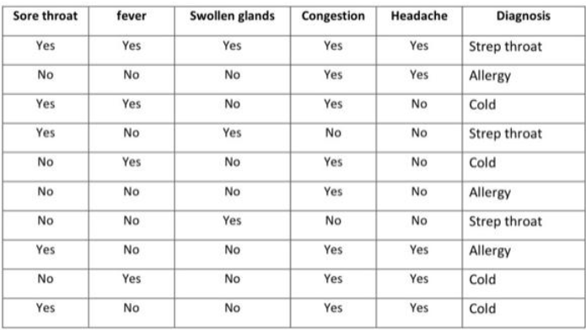
Yes

Slide 30
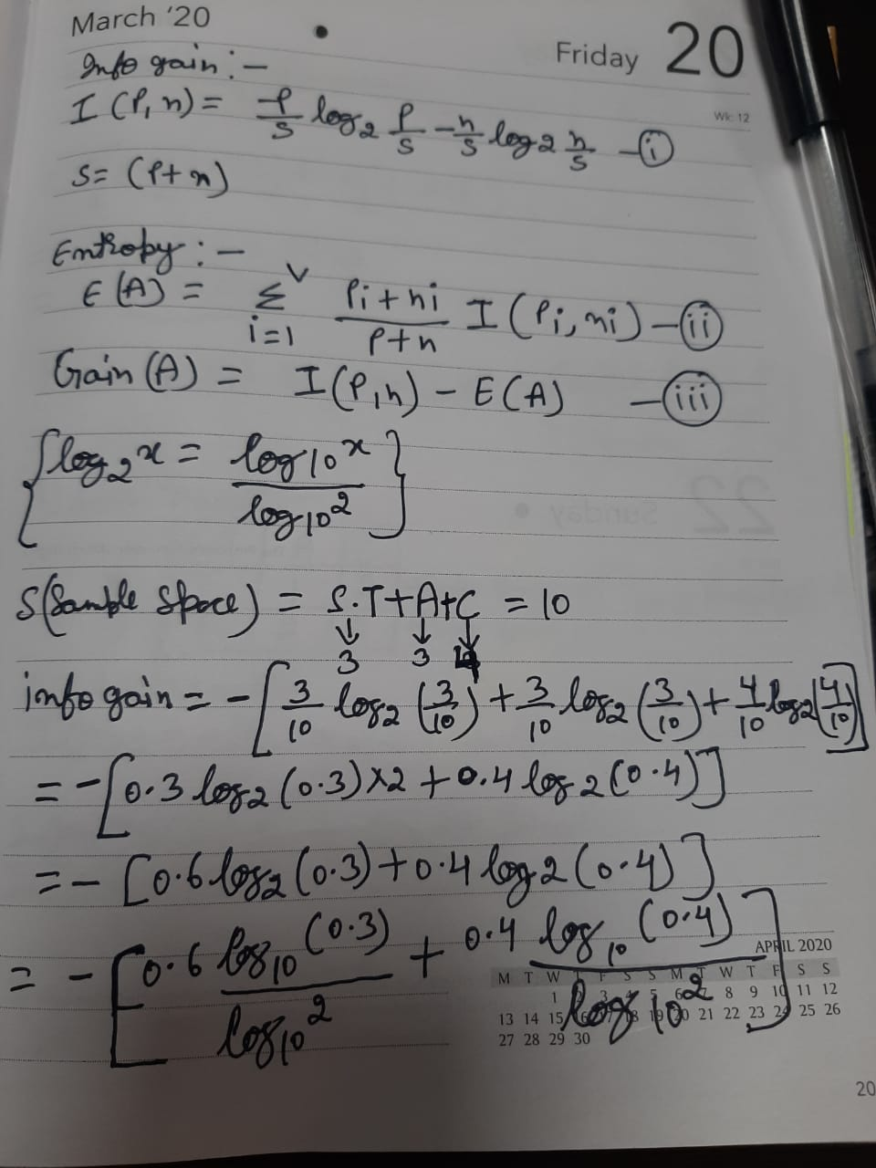

Slide 31
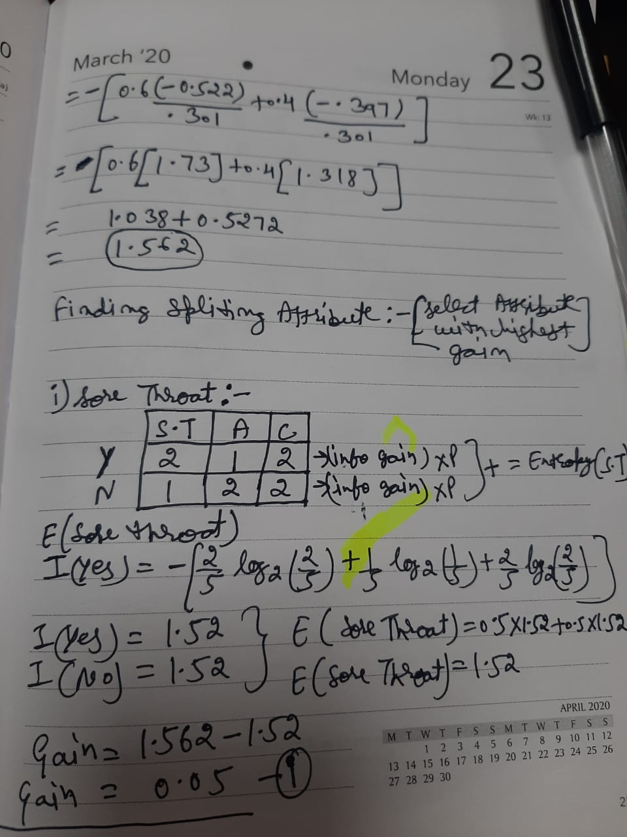

Slide 32
